Slide 1
AuraDB Knowledge Graph Creation
Dāvis Palieks

Slide 2
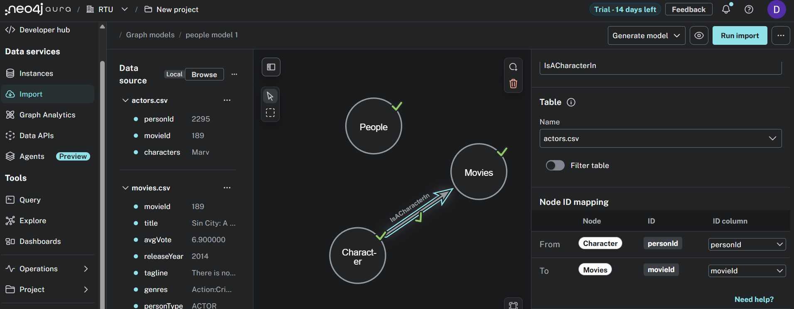
AuraDB Import/Schema

Slide 3
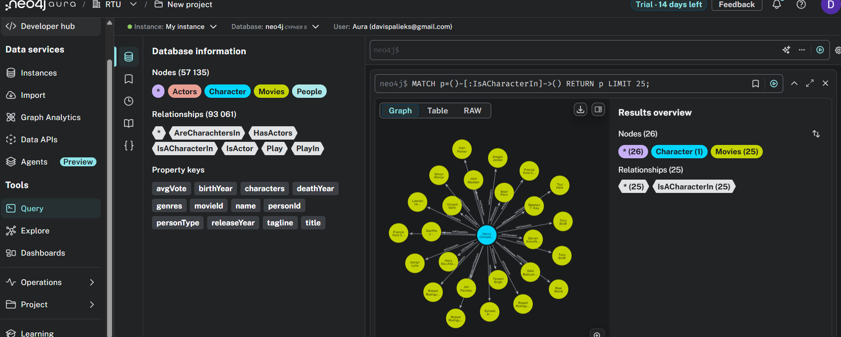
Query

